Slide 1


Slide 2
Definition : The KNN algorithm is simplest supervised machine learning algorithm mostly used for classification.It classifies a data point based on how its neighbors are classified.
Features of KNN :
Implicitly constructs the decision boundaries.
The goal is to classify an unknown training sample into one of C classes.
KNN is both Linearly separable and Non linearly separable data.
KNN captures the idea of similarity (sometimes called distance,proximity).It is based on feature similarity.
KNN algorithm assumes that similar things exist in class proximity.Therefore,similar things are close to each other.
KNN algorithm works pretty well with a small number of input variables (p), but there are more chances of error in prediction when the number of inputs becomes very large.

Slide 3
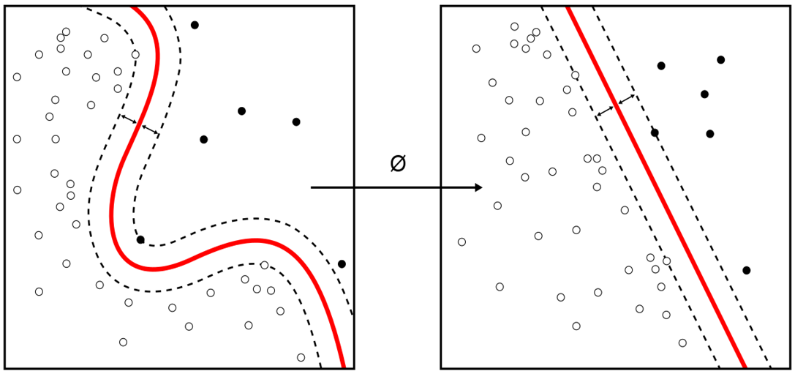
Non-Linearly Separable Linearly Separable

Slide 4
Notation of KNN :
Training samples : (x1,y1) , (x2,y2) , (x3,y3)………….(xn,yn)
x is the feature vector with n number of features.
Whereas ,y is a class label of {1,2,3………n}.
Goal is to determine Y(new) for X(new) using distance metrics .

Slide 5
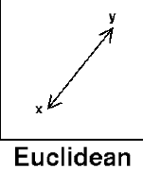

Some of the distance measuring techniques we use in KNN :
1. Euclidian Distance
We use this method as it treats each feature as equally important.
When we are having less features in the dataset in that case we use this distance method.
It is the most popular and familiar choice which we use to calculate the distance between the two data points in a plane.(p=2)
x = (x1,x2,…………xn) and y = (y1,y2,…………yn), is

Slide 6
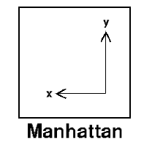

2.Manhattan Distance
We use Manhattan Distance if we need to calculate the distance between two data points in a grid like path.
Let’s say, we want to calculate the distance, between two data points x and y.
Manhattan distance will be calculated using an absolute sum of difference between its cartesian co-ordinates as below :
where, n - number of variables, xi and yi are the variables of vectors x and y respectively, in the two dimensional vector space.(p=1)
i.e. x = (x1,x2,x3,...) and y = (y1,y2,y3,…), it will be calculated as below
(x1 - y1) + (x2 - y2) + (x3 - y3) + … + (xn - yn).

Slide 7
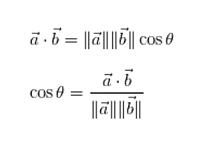
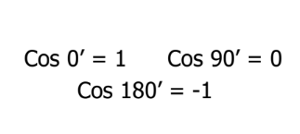
3.Cosine Distance
Mostly Cosine distance metric is used to find similarities between different data points. In cosine metric we measure the degree of angle between two documents/vectors.This particular metric is used when the magnitude between vectors does not matter but the orientation.
Cosine similarity formula can be derived from the equation of dot products :
Here cosine value 1 is for vectors pointing in the same direction i.e. there are similarities between the data points. At zero for orthogonal vectors i.e. Unrelated (some similarity found). Value -1 for vectors pointing in opposite directions(No similarity).
Ranges from [-1 , 1].

Slide 8
Working of KNN :
Step 1 − For implementing any algorithm, we need dataset. So during the first step of KNN, we must load the training as well as test data.
Step 2 − Next, we need to choose the value of K i.e. the nearest data points. K can be any integer.
Step 3 − For each point in the test data do the following −
3.1 − Calculate the distance between test data and each row of training data with the help of any of the method namely: Euclidean, Manhattan or cosine distance. The most commonly used method to calculate distance is Euclidean.
3.2 − Now, based on the distance value, sort them in ascending order.
3.3 − Next, it will choose the top K rows from the sorted array.
3.4 − Now, it will assign a class to the test point based on most frequent class of these rows.
Step 4 − End

Slide 9
How to choose the value of K
1.Determine the value of K.
The first step is to determine the value of K. The determination of the K value varies greatly depending on the case. If using the Scikit-Learn Library the default value of K is 5.
2.Calculate the distance of new data with training data. To calculate distances, 3 distance metrics that are often used are Euclidean Distance, Manhattan Distance, and Cosine Distance.When we use Sk-Learn, the default distance used is Euclidean. It can be seen in the Minkowski distance formula that there is a Hyperparameter p , if set p = 1 then it will use the Manhattan distance and p = 2 to be Euclidean.
3. Find the closest K-neighbors from the new data.
After calculating the distance, then look for K-Neighbors that are closest to the new data. If using K = 3, look for 3 training data that is closest to the new data.
4. New Data Class Prediction.
To determine the class of new data, select the class of training data that closest to the new data and have the highest quantity.
5. Evaluation.
Calculate the accuracy of the model, if the accuracy is still low, then this process can be repeated again from step 1.

Slide 10
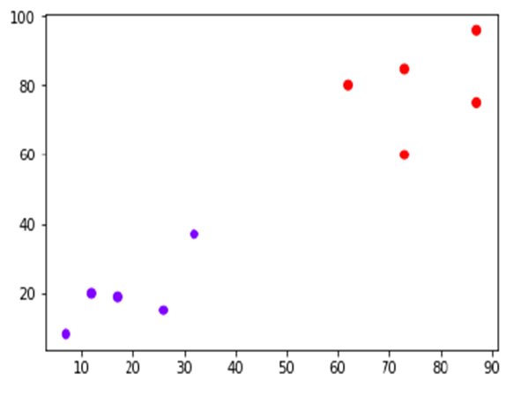
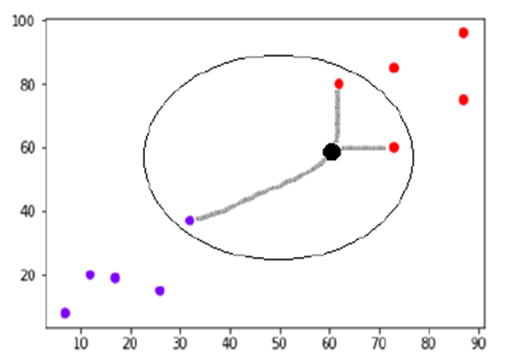
K=3

Slide 11
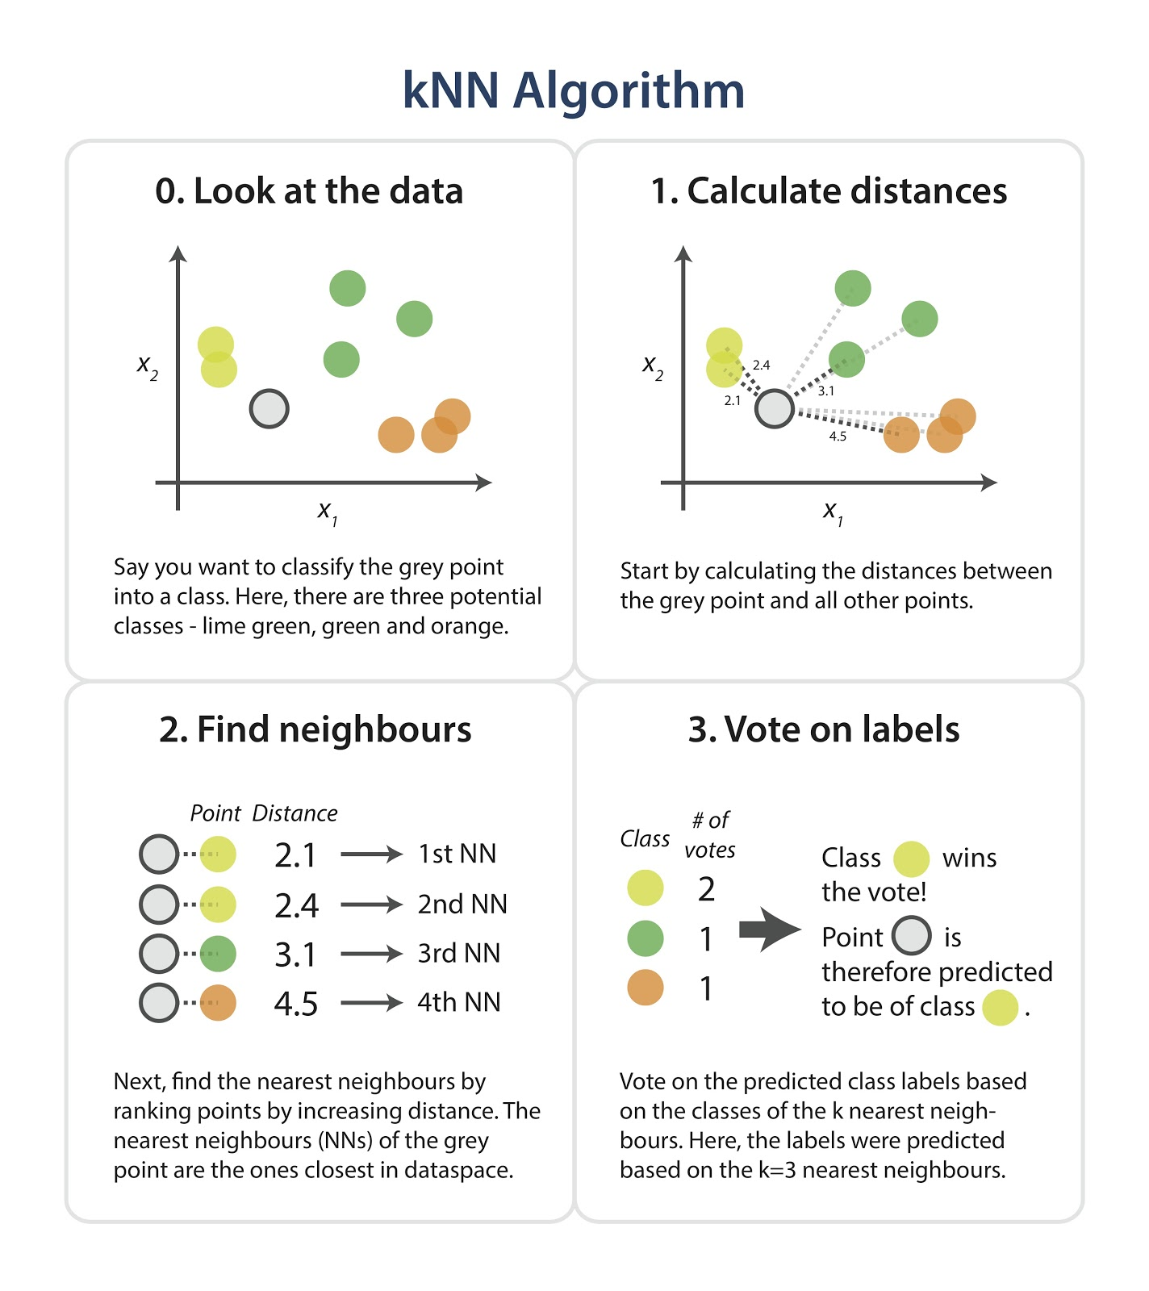

Slide 12
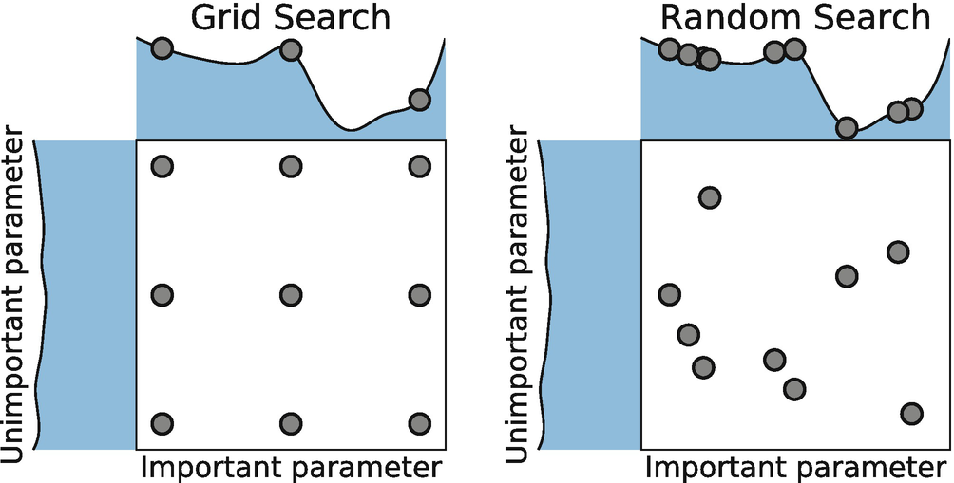
Hyperparameter Tuning:
Hyperparameter tuning is choosing a set of optimal hyperparameters for a learning algorithm.
In sklearn,hyperparameters are passed in as arguments to the constructor of the model classes.While this is an important step in modeling, it is by no means the only way to improve performance.
Tuning Strategies
There are two different methods for optimizing hyperparameters:
1.Grid Search
2.Random Search

Slide 13
1.Grid Search
Grid search is a traditional way to perform hyperparameter optimization. It works by searching exhaustively through a specified subset of hyperparameters.
The benefit of grid search is that it is guaranteed to find the optimal combination of parameters supplied. The drawback is that it can be very time consuming and computationally expensive.
We can combat this with random search.
2.Random Search
Random search differs from grid search mainly in that it searches the specified subset of hyperparameters randomly instead of exhaustively. The major benefit being decreased processing time.
There is a tradeoff to decreased processing time, however. We aren’t guaranteed to find the optimal combination of hyperparameters.

Slide 14
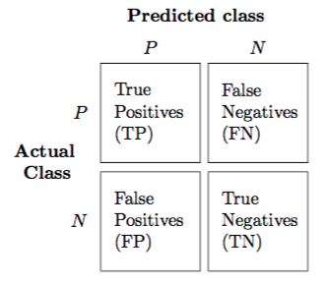
Peformance Metrics :
The most widely used technique for summarizing the performance of a classification algorithm is the Confusion Matrix .Figure shows the confusion matrix for the case of binary classification with the following elements:
1.True Positives (TP) is defined by the total number of accurate outputs when the actual class of the data object was True and the prediction was also the True value.
2.True Negatives (TN) is defined by the total number of accurate outputs when the actual class of the data object was False and the predicted is also the False value.
3.False Positives (FP) when the actual class of the data object was False and the output value was the True value.
4.False Negatives (FN) when the actual class of the data object was True and the output value was the False value.

Slide 15
Metrics computed from a confusion matrix :
A confusion matrix gives a useful information about how well the model does. However, its elements can be used to calculate many performance metrics.
1.Accuracy - is the most intuitive performance measure, and defined as the ratio of the number of correctly classified objects to the total number of objects evaluated.
2.Precision - it is simply a ratio of correctly predicted positive data objects to the total predicted positive data objects.
3.Recall - it is defined by the number of correct positive results divided by the total number of relevant samples (all samples that should have been identified as positive).
4.F-score - it can be defined as a weighted average of the precision and recall. An F-score is considered perfect when reaches its best value at 1, while the model is a total failure when it reaches the 0 value.

Slide 16
Overfitting and Underfitting :
Overfitting:
Good performance on the training data, poor generliazation to other data.
A statistical model is said to be overfitted, when we train it with a lot of data.
When a model gets trained with so much of data, it starts learning from the noise and inaccurate data entries in our data set.
Then the model does not categorize the data correctly, because of too much of details and noise.
The causes of overfitting are the non-parametric and non-linear methods because these types of machine learning algorithms have more freedom in building the model based on the dataset and therefore they can really build unrealistic models.
A solution to avoid overfitting is using a linear algorithm if we have linear data or using the parameters like cross-validation.
If K=1,it will be overfitted model.

Slide 17
Underfitting :
Poor performance on the training data and poor generalization to other data.
A statistical model or a machine learning algorithm is said to have underfitting when it cannot capture the underlying trend of the data.
Underfitting destroys the accuracy of our machine learning model. Its occurrence simply means that our model or the algorithm does not fit the data well enough.
It usually happens when we have less data to build an accurate model and also when we try to build a linear model with a non-linear data.
In such cases the rules of the machine learning model are too easy and flexible to be applied on such a minimal data and therefore the model will probably make a lot of wrong predictions.
Underfitting can be avoided by using more data and also reducing the features by feature selection.
If K=n then it will be underfitted model.

Slide 18
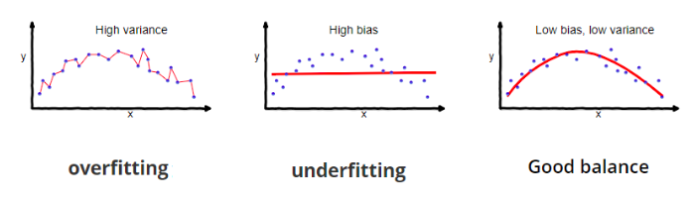

Slide 19
Time and Space Complexity :
Time Complexity → O(nxd)
- As n training samples of d dimension.
Space Complexity → O(nxd)
- We must be able to keep the entire training dataset in memory and performing classifications can be computationally expensive as the algorithm pass through all data points for each classification.

Slide 20
Pros and Cons of KNN :
Pros -
It is very simple algorithm to understand and interpret.
It is very useful for nonlinear data because there is no assumption about data in this algorithm.
It is a versatile algorithm as we can use it for classification as well as regression.
It has relatively high accuracy but there are much better supervised learning models than KNN.
Cons -
It is computationally a bit expensive algorithm because it stores all the training data.
High memory storage required as compared to other supervised learning algorithms.
Prediction is slow in case of big N.
It is very sensitive to the scale of data as well as irrelevant features.

Slide 21
Applications of KNN :
The following are some of the areas in which KNN can be applied successfully −
Banking System
KNN can be used in banking system to predict weather an individual is fit for loan approval or not.
Calculating Credit Ratings
KNN algorithms can be used to find an individual’s credit rating by comparing with the persons having similar traits.
Politics
With the help of KNN algorithms, we can classify a potential voter into various classes like “Will Vote”, “Will not Vote”, “Will Vote to Party ‘Rose’, “Will Vote to Party ‘Lily’.Other areas in which KNN algorithm can be used are Speech Recognition, Handwriting Detection, Image Recognition and Video Recognition.

Slide 22


